Slide 1
Fundamentals of Computer Networks and Management
Atul Kahate

Slide 2
Sessions 1 and 2

Slide 3
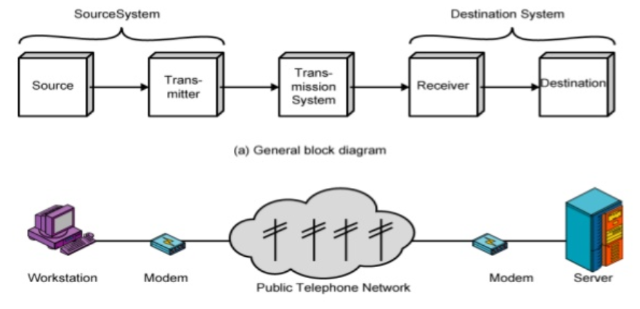
Introduction to Communication System
A communication system is a set of interconnected components or devices that enable the transmission, reception, and exchange of information between two or more parties

Slide 4
Components of a Data Communication System
Source: The source generates the information to be transmitted, which can be in the form of speech, data, video, or any other type of message
Transmitter: The transmitter processes the information from the source and converts it into a suitable form for transmission, e.g. by modulation (changing the signal's characteristics) and amplification
Channel: The channel is the physical or logical medium through which the signal travels (wired - copper or fiber-optic cables or wireless - radio waves, microwaves, or infrared)
Receiver: The receiver receives the transmitted signal and converts it back into a form that can be understood by the destination, e.g. by demodulation and signal processing
Destination: The destination is the recipient of the transmitted information, e.g. a person, another device, or a computer system

Slide 5
Issues in Computer Networking
Bandwidth Limitations
Latency
Packet loss
Network congestion
Security threats
Data privacy
Scalability
Interoperability
Network management
Quality of Service

Slide 6
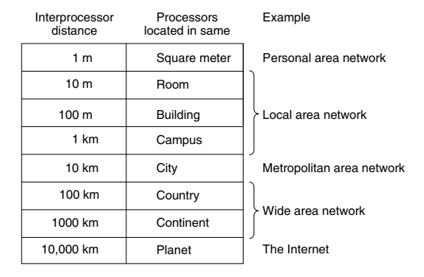
Scale and Network Types

Slide 7
Local Area Network (LAN)
Local Area Network (LAN): A privately owned network that operates within a single building like a home, office or factory
Wireless LANs: In these systems, every computer has a wireless modem and an antenna that it uses to communicate with other computers
An access point or base station controls the network
IEEE 802.11 standard (also called WiFi) describes this

Slide 8
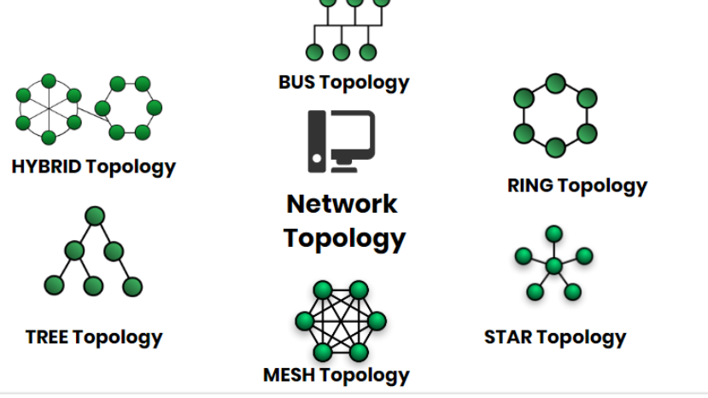
Network Topology
Network Topology represents a network arrangement consisting of several nodes

Slide 9
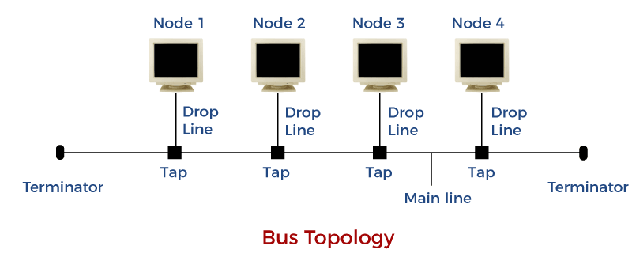
Bus Topology
All the nodes are connected to a common wire, called as bus
Simple and cost-effective, but all depends on a single cable, not fast

Slide 10
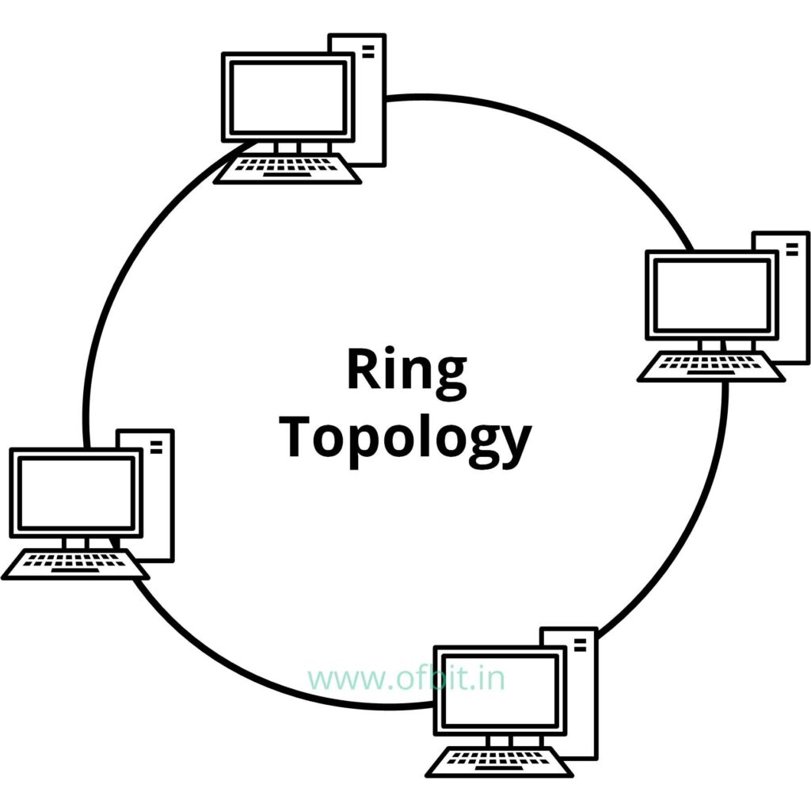
Ring Topology
One computer is connected to the next, and so on, to complete a ring
A transmitting computer needs to have a token, before transmitting
Inexpensive, Tough to add or remove nodes, One node crashing can disconnect the whole network

Slide 11
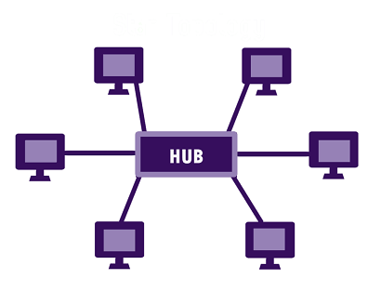
Star Topology
Each device is connected to a central hub
All communication goes through the hub only
Simple, too much of dependence on the hub, but the hub can be upgraded easily, Easy to troubleshoot, Cost is high

Slide 12
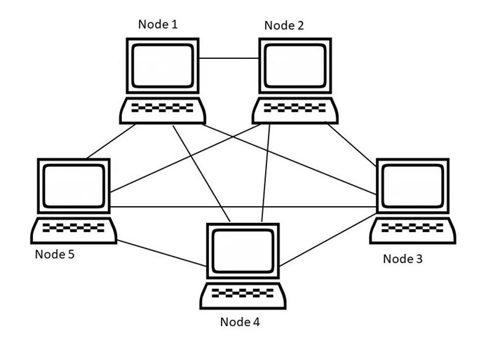

Mesh Topology
All nodes are connected to each other
Point-to-point connection, so for n nodes: $n x \left(n−1\right)÷2$ links
Very robust, Easy to diagnose errors, Privacy and security are better, Costly, Too much of wiring

Slide 13
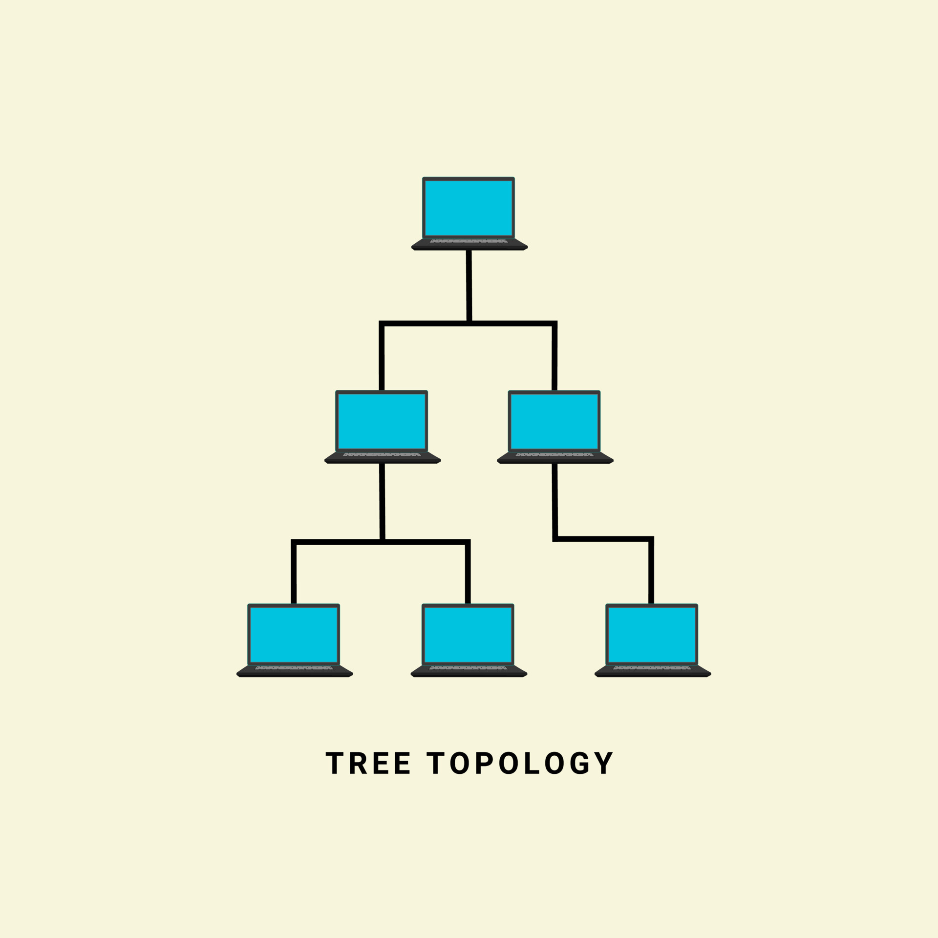
Tree Topology
Nodes are connected hierarchically, ultimately connecting to the top node, called as the root node
Has at least three levels of hierarchy
Easy to expand and manage, debug
Expensive, lot of cabling

Slide 14
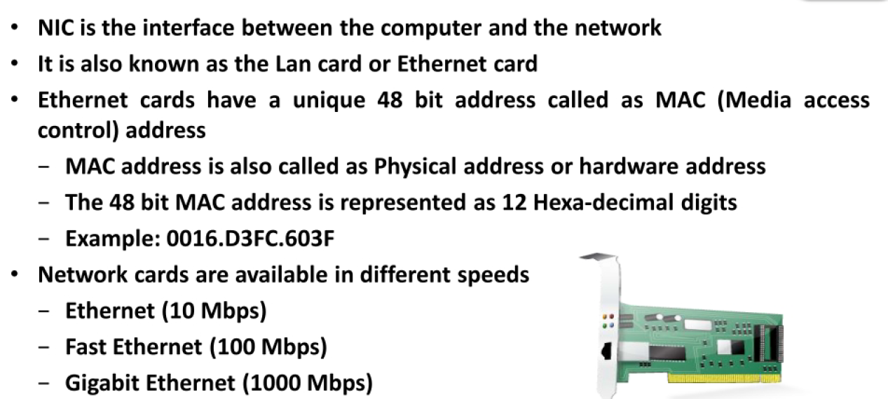
Network Interface Card (NIC)

Slide 15
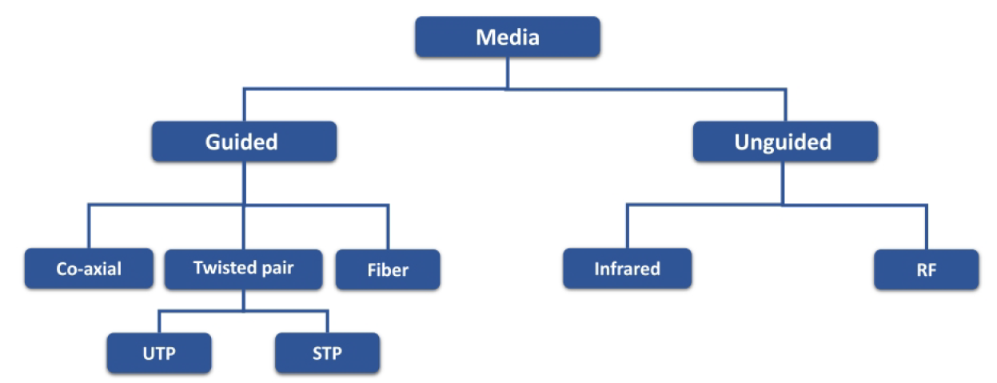
Transmission media

Slide 16
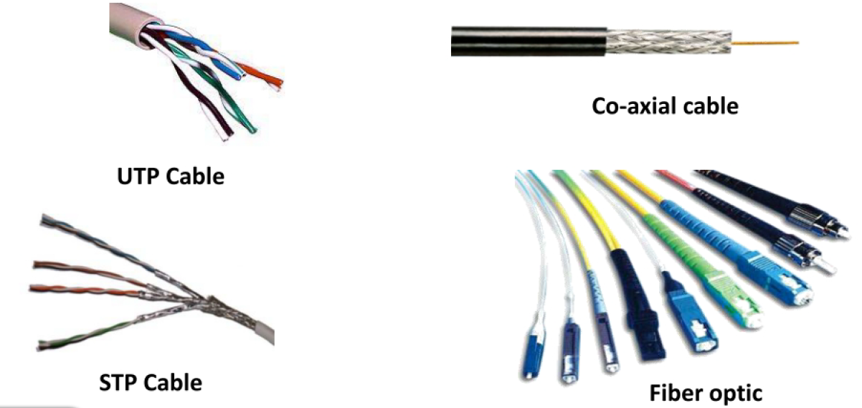
Transmission media

Slide 17
Transmission Media
Transmission medium: Carries information from a source to a destination
Guided media (Wired) include twisted-pair cable (uses electric current), coaxial cable (uses electric current), fiber-optic cable (uses light)
Unguided medium (Wireless) is air

Slide 18
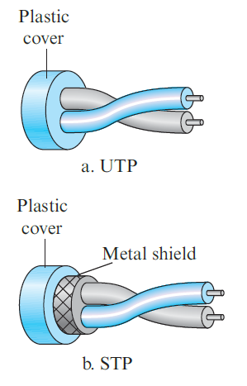
Twisted-pair cable
Consists of two copper wires
Two types
Unshielded twisted-pair (UTP)
Shielded twisted-pair (STP)
Used in telephone networks

Slide 19
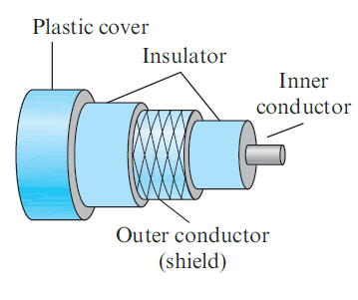
Coaxial cables
Coaxial cable (or coax) carries signals of higher frequency ranges than those in twisted-pair cable
Instead of having two wires, coax has a single copper wire
Usage: Telephone, Cable TV, LAN

Slide 20
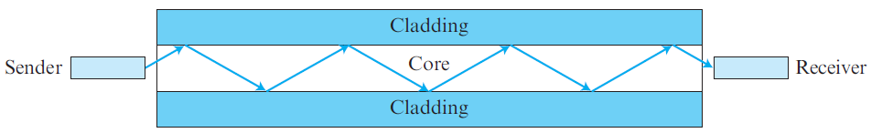
Fiber-optic cable
Made of glass or plastic and transmits signals in the form of light
Modern Ethernet is fiber optic-based

Slide 21
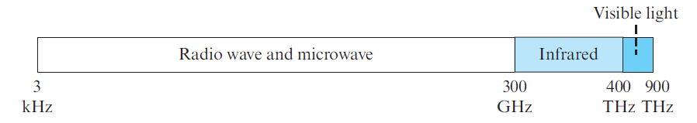
Unguided media
Use electromagnetic waves – no wire is needed
Also called as wireless communication
Signals are normally broadcast through free space and thus are available to anyone who has a device capable of receiving them
The part of the electromagnetic spectrum, ranging from 3 kHz to 900 THz is used for wireless communication.

Slide 22
Ethernet
Most popular LAN technology
Earlier, we also had Token Ring, Token Bus, etc
Ethernet generations
Standard Ethernet (10 Mbps)
Fast Ethernet (100 Mbps)
Gigabit Ethernet (1 Gbps)
10 Gigabit Ethernet (10 Gbps)

Slide 23
Earlier Ethernet – Classic Ethernet
Carrier sense multiple access with collision detection (CSMA/CD) technique was used
Allow any host to send data
If two hosts transmit at the same time, collision happens
They recover using CSMA/CD

Slide 24
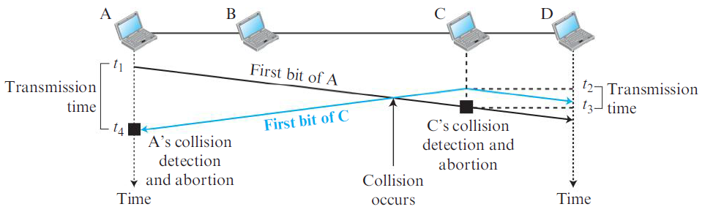
CSMA/CD

Slide 25
Modern Ethernet: Switched Ethernet
Devices called switches are used to connect different computers
Classic Ethernet is the original form and ran at rates from 3 to 10 Mbps
Switched Ethernet
Fast Ethernet: 100 Mbps
Gigabit Ethernet: 1000 Mbps (1 Gbps)
10 Gigabit Ethernet: 10,000 Mbps (10 Gbps)
In practice, only switched Ethernet is used nowadays

Slide 26
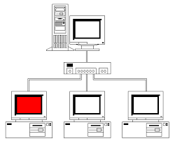
Switched Ethernet
Hosts connect into switches, and switches connect to each other
Ethernet switch

Slide 27
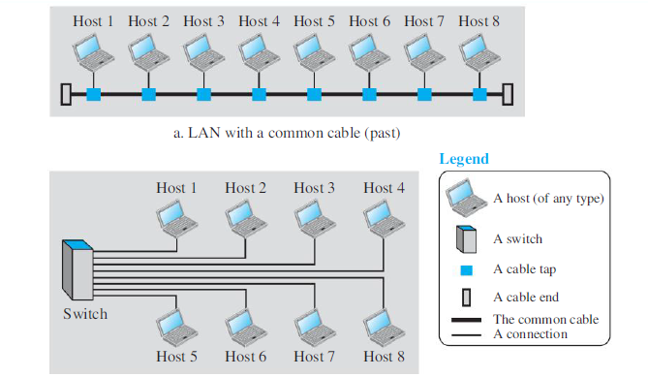
LAN – Earlier and Now

Slide 28
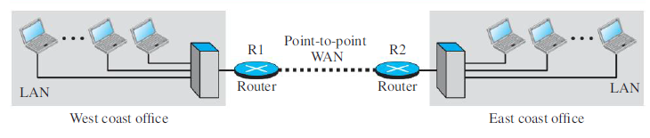
Wide Area Network (WAN)
A Wide Area Network (WAN) spans a large geographical area, often a country or continent
Example: Two LANs can be connected to form a WAN

Slide 29
Sessions 3 and 4

Slide 30
Protocol
Communication between two people or two devices needs to follow some protocol
A protocol is a set of rules that governs communication
For example, in a face-to-face communication between two persons, there is a set of implicit rules in each culture that define how two persons should start the communication, how to continue the communication, and how to end the communication

Slide 31
Network Software
Network software uses a protocol stack
A protocol stack contains many layers or levels
Each layer provides some services to the layer above it
Each layer hides complexity of its work from the layer above it
Creates a protocol hierarchy

Slide 32
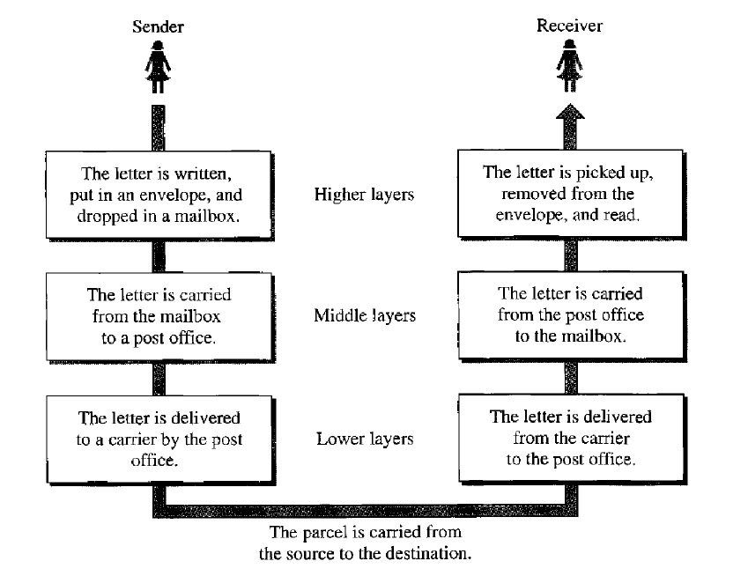
Protocol Hierarchy Example

Slide 33
OSI
Open Systems Interconnection
Good in theory, not used in practice
Contains 7 layers
Sometimes also called ISO/OSI

Slide 34
Layers in OSI
Application Layer
Presentation Layer
Session Layer
Transport Layer
Network Layer
Data Link Layer
Physical Layer
Notes:
34

Slide 35
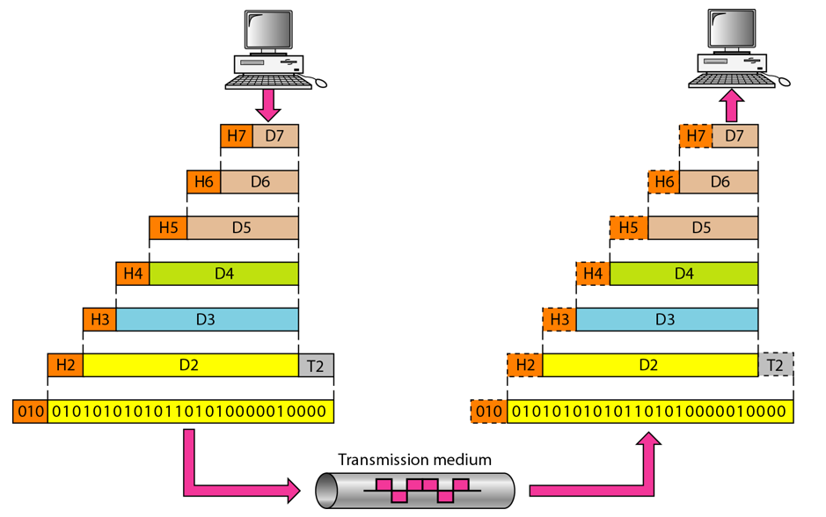
An Exchange using the OSI Model

Slide 36
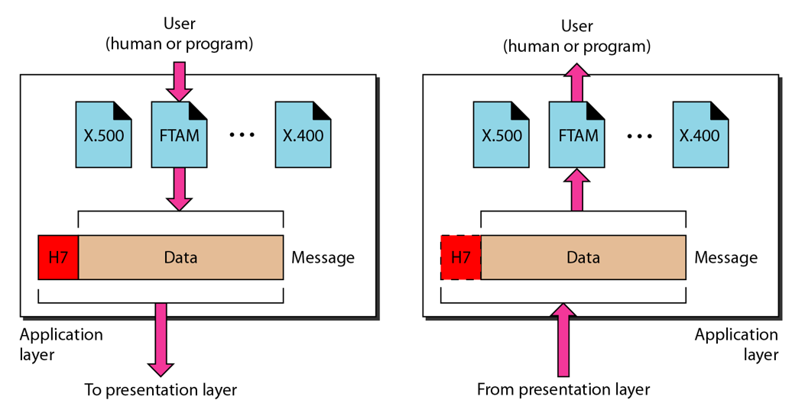
The Application Layer

Slide 37
Application Layer
Provides an “application view” to a network (e.g. email, file transmission)
Example: Hypertext Transfer Protocol (HTTP) is used to access Web pages
Encapsulation begins here
Other examples: Email (SMTP), File transfers (FTP), Querying domain names (DNS)

Slide 38
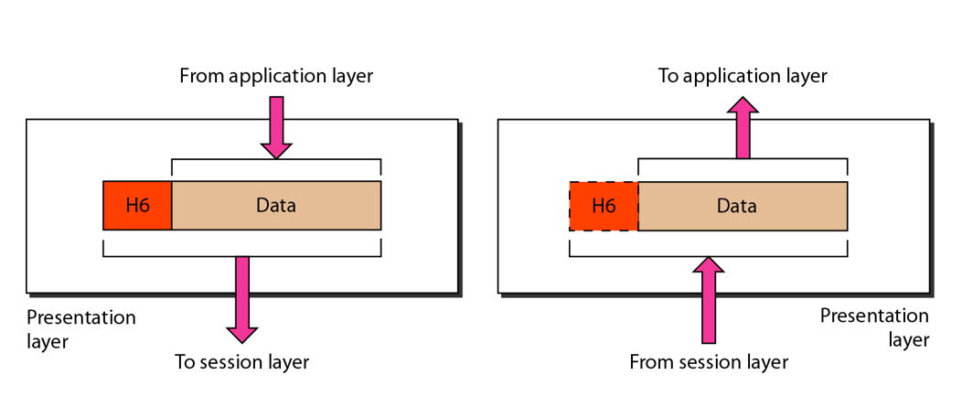
The Presentation Layer

Slide 39
Presentation Layer
Translation: Use of a common format to take care of differences (encoding, number representation etc)
Encryption: To achieve confidentiality or privacy
Compression: Reduces the number of bits needed to be transmitted

Slide 40
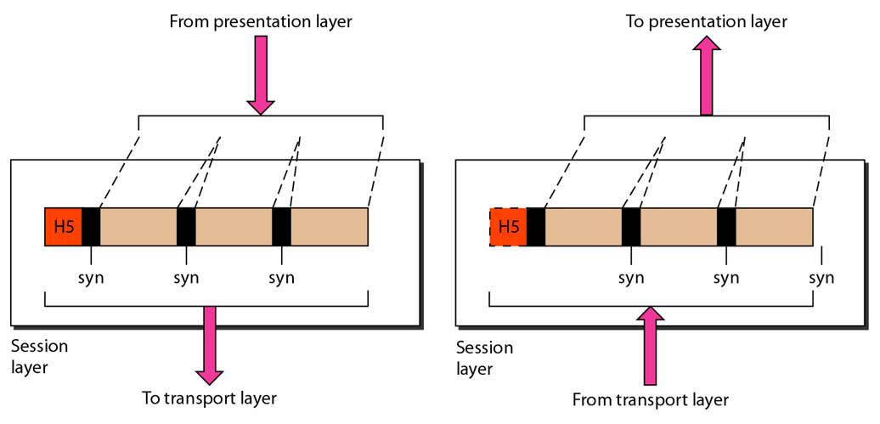
The Session Layer

Slide 41
Session Layer
Manages the session between applications
Example: Between browser of the source computer and server of the destination computer

Slide 42
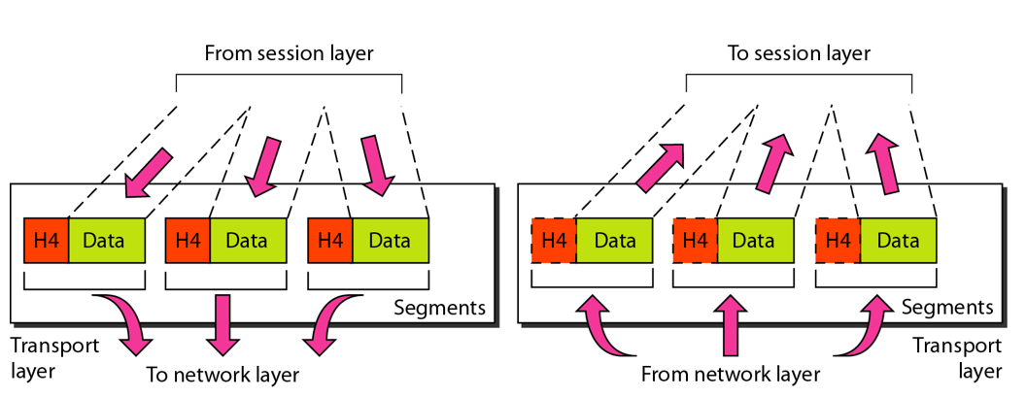
The Transport Layer

Slide 43
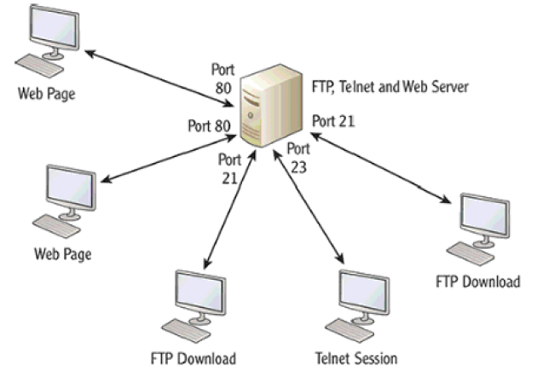
Transport Layer
Identifies the application on the destination computer using port numbers
Example: One server, multiple applications

Slide 44
Port Numbers
Port number is a 16-bit value, so it can store a number between 0 and 65,535
Port Number Range | Where used? | Called as
0-1023 | Server | Well-known ports
1024-49151 | Client | Temporary/Ephemeral
49152-65535 | NA | Dynamic, Usage-based

Slide 45
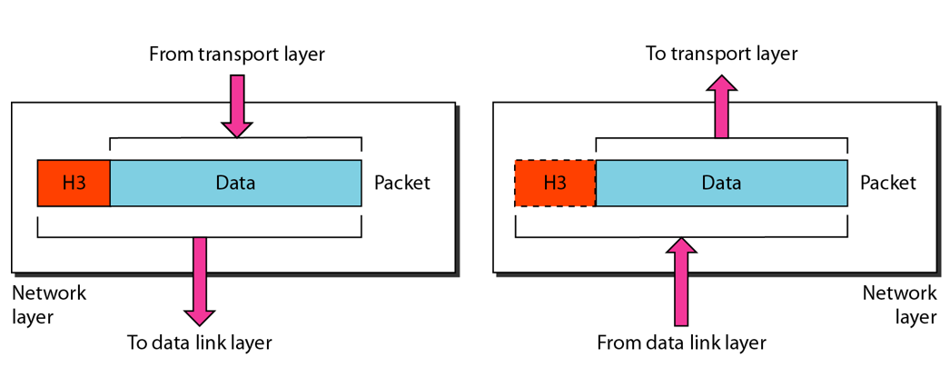
The Network Layer

Slide 46
Network Layer
Physical/MAC addresses are defined by data link layer to take care of addressing inside the same network
If a packet has to travel across a network to another network, physical addressing will not work
Hence, a universal address or a logical address is required. This is done at the network layer
This is the IP address

Slide 47
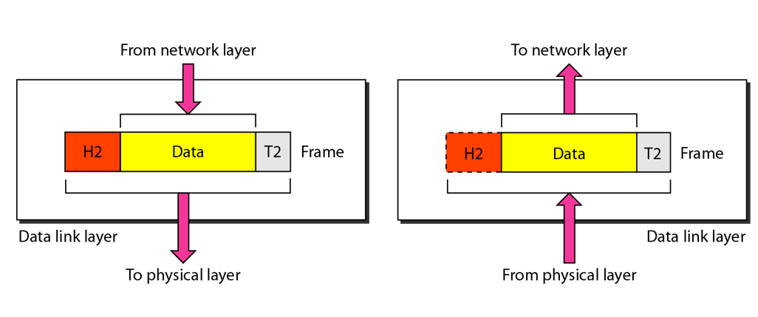
The Data Link Layer

Slide 48
Data Link Layer
Responsible for delivery of packets between two hosts connected to the same physical network (hop-to-hop – see next slide)
Cannot work across networks
Uses frames
Physical addressing: Adding sender’s and receiver’s physical addresses (also called MAC addresses) to the frame header
LAN/WAN operates at this layer (e.g. Ethernet or WiFi)
What if we know the IP address of a computer but do not know its MAC address?
Use Address Resolution Protocol (ARP)

Slide 49
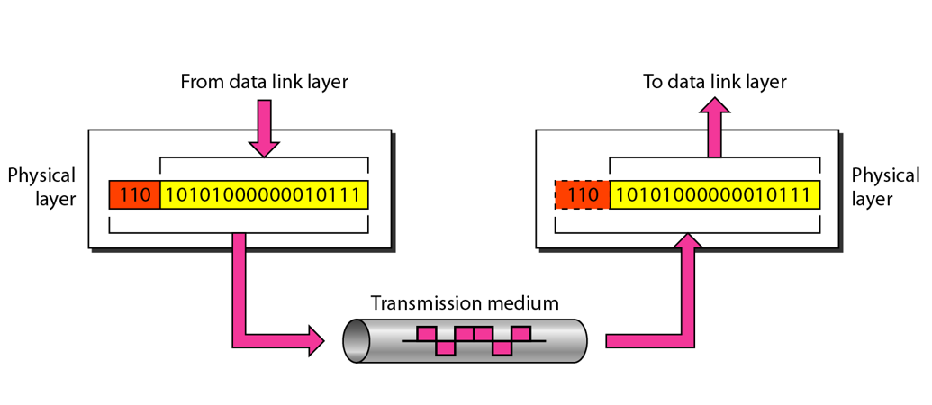
The Physical Layer

Slide 50
Physical Layer Functions
Carries the data (0s and 1s) in the form of signals
Signals can be electric, optical, or wireless

Slide 51
Physical and Logical Address
Each computer on the Internet has two addresses:
Physical address/MAC address/Hardware address
Fixed address, hardcoded on the Network Interface Card (NIC)
Different for different network type (e.g. Ethernet card, WiFi card)
Useful within or inside a network only
Logical address/IP address/Virtual address
Exists in software
Given by the network provider or your organization (usually temporary)
Useful outside a network (e.g. to reach another computer on the Internet, anywhere in the world)

Slide 52
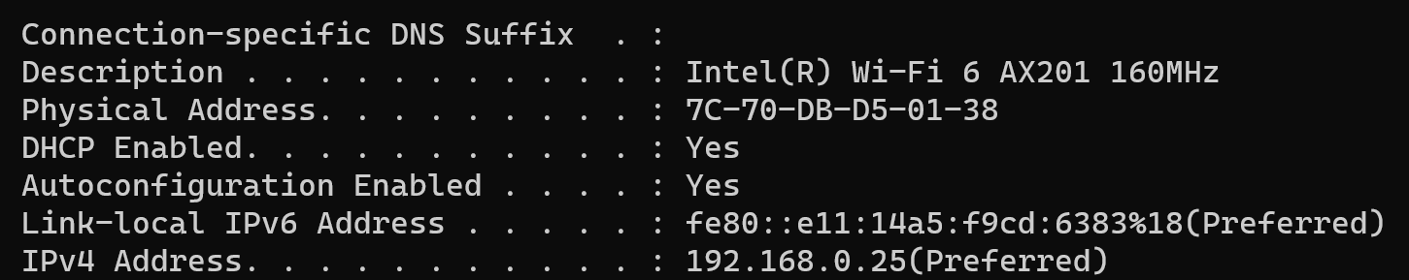
Example

Slide 53
Example
Suppose we have used our web browser to access a web page located on our company’s web server
Consider that the following are the details of the two computers
Computer | IP Address | MAC Address | Port Number
Web server | 192.168.5.1 | 5-5-5-5-5-5 | TCP 80
Laptop | 192.168.5.2 | 6-6-6-6-6-6 | TCP 5091

Slide 54
How will the Web Server Respond?
Layer 7 obtains the data in the form of the HTML document.
Layer 6 adds information about the formatting.
Layer 5 adds information required to create a session between the web server and the web browser on the laptop.
Layer 4 adds the transport protocol and the source and destination port numbers, in this case TCP (it's a unicast) and port 80 (HTTP).
Layer 3 adds the source and destination IP addresses, in this case a source of 192.168.5.1 and a destination of 192.168.5.2.
Layer 2 learns the destination MAC address and adds the source and destination MAC addresses, in this case, a source of 5-5-5-5-5-5 and destination of 6-6-6-6-6-6.
Layer 1 converts the entire package into bits and sends it across the network to the laptop.

Slide 55
How will the Laptop Handle this?
Layer 1 receives the bits in electrical format, converts them to be read by layer 2, and hands them to layer 2.
Layer 2 examines the destination MAC address to see whether it is addressed to it, sees the MAC address of 6-6-6-6-6 (its own), drops that part of the transmission, and hands the remaining data to layer 3.
Layer 3 examines the destination IP address to ensure that it is its own (192. 168.5.2), drops that part, and hands the rest of the package to layer 4.
Layer 4 examines the destination port number (port 5091), alerts the browser that HTTP data is coming in, drops that part, and hands the rest of the package to layer 5.
Layer 5 uses the information that was placed on this layer by the web server to create the session between the web server and the web browser and then hands the rest of the information to layer 6.
Layer 6 performs any format translation that may be required and hands the remaining data (the HTML document) to layer 7.
The layer 7 application (the web browser) receives the HTML document and opens the document in the browser window.

Slide 56
TCP/IP

Slide 57
Basics of TCP/IP
The TCP/IP protocol suite was developed prior to the OSI model
Therefore, the layers in the TCP/IP protocol suite do not match exactly with those in the OSI model
The original TCP/IP protocol suite was defined as four software layers built upon the hardware
Sometimes TCP/IP is thought of as a five-layer model with the layers named similarly to the ones in the OSI model

Slide 58
OSI versus TCP/IP
When we compare the two models, we find that two layers, session and presentation, are missing from the TCP/IP protocol suite
These two layers were not added to the TCP/IP protocol suite after the publication of the OSI model
The application layer in the suite is usually considered to be the combination of three layers in the OSI model
See diagram on the next slide

Slide 59
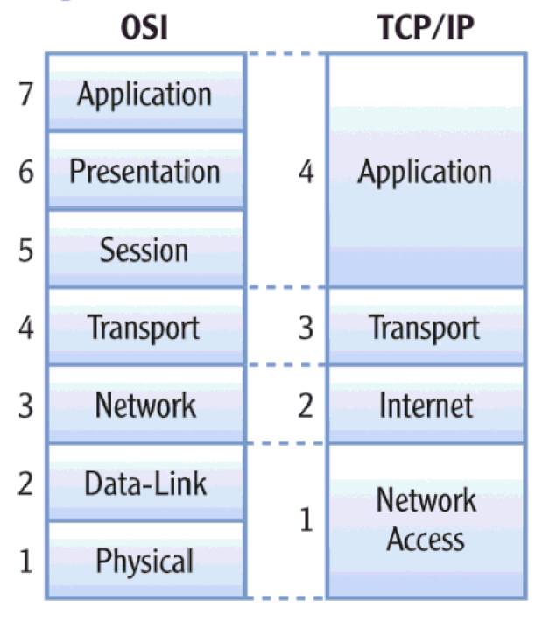
OSI versus TCP/IP

Slide 60
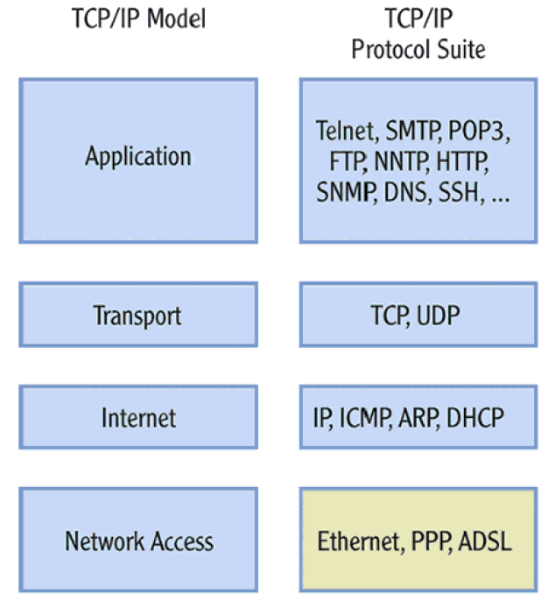
Protocols within Each TCP/IP Layer

Slide 61
Transport Layer Protocols
Transmission Control Protocol (TCP)
Reliable protocol
Guaranteed delivery
Uses connections, acknowledgements
Used for text-based data
User Datagram Protocol (UDP)
Unreliable protocol
No guarantee of delivery
No connections, no acknowledgements
Useful for audio, video or wherever we need speed but not guarantee

Slide 62
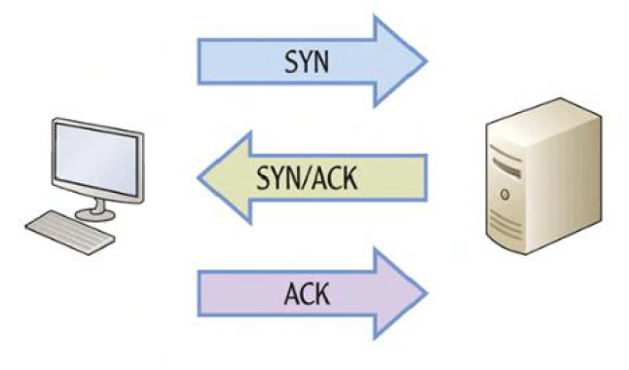
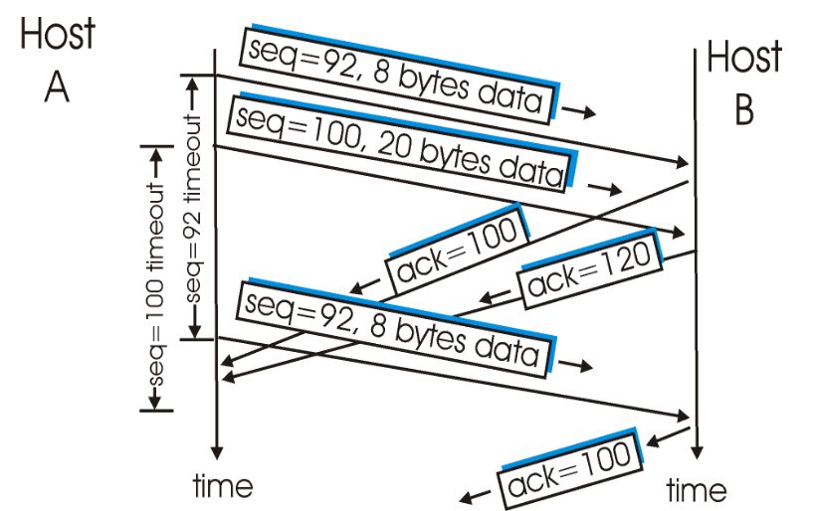
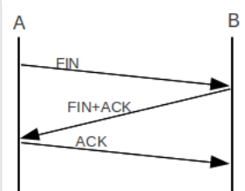
TCP – Connection Management
Connection establishment
Data transfer
Connection termination

Slide 63
UDP
No connection
No acknowledgement
No retransmissions in the case of errors

